Slide 1
MATLAB for image processing Session 4: Figures and plotting

Slide 2
Course structure
Session 1
Introduction to MATLAB
Data types
Conditional statements and loops
Session 3
Advanced data structures
Object-oriented programming
Advanced image reading (Bio-Formats)
Session 2
Arrays and matrices
Image processing
Session 4
Figures and plotting
Designing a user interface

Slide 3

Under construction!
Comments/requests?
Let me know!
stephen.cross@bristol.ac.uk

Slide 4
Figures
Notes:
Convert this into 2 spider diagrams if there’s time

Slide 5
Already seen the figure window
This is main component of all GUI elements.
Figures are objects (as covered in Session 3). Mention some properties
List things that may go into a figure (show a few examples)
Images
Display array of pixels by their intensity
Maybe cover some extra functionality? Not sure if there’s anything particularly interesting
Plots
Drawn inside axes
Many built-in plotting types (histograms, line graphs, point graphs, 3D plots)
Would be nice to have a short video showing a 3D graph being manipulated
When talking about properties include axis labels, title, tick marks
Control elements
Buttons, sliders, menus
Can combine different elements within the same figure window
Maybe show an example window from one or two of my early programs
Talk about graphical element hierarchy (parent-child relationship)

Slide 6
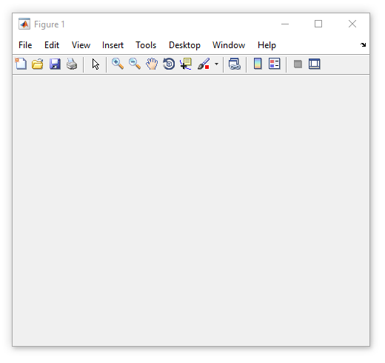
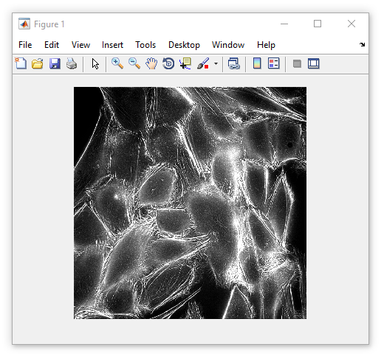
Introduction to figures
All graphical components live within a figure
The figure object is simply a container window
A figure is an object (Session 3)
Properties include
Name (title)
Position
Methods include
delete (close window)
We’ve used figures when viewing images
my_fig = figure()
imshow(some_image, [])

Slide 7
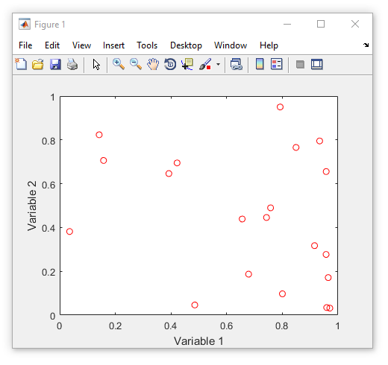
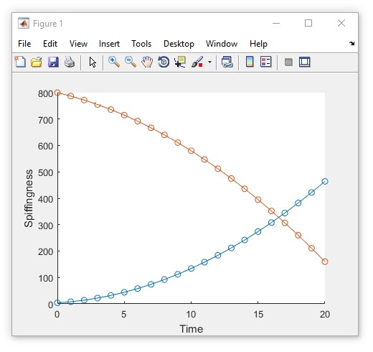
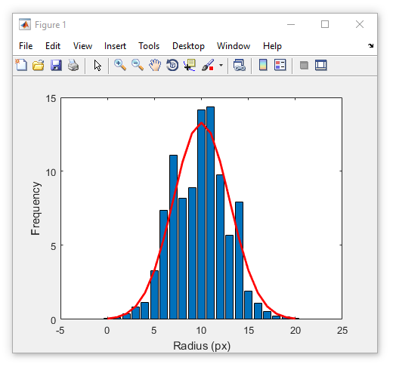
What can go in a figure?
Images
Data plots
Controls
Notes:
Figure size = [758 558 482 365]

Slide 8
Some handy figure functions
clf
gcf
close all

Slide 9
Plotting
Notes:
Convert this into 2 spider diagrams if there’s time

Slide 10
Plotting data
All graphical components live within a figure
The figure object is simply a container window
A figure is an object (Session 3)
Properties include
Name (title)
Position
Methods include
delete (close window)
We’ve used figures when viewing images
my_fig = figure()
imshow(some_image, [])

Slide 11
Talk about plotting
Talk about main concepts using scatter plot
The axes objects
Changing line properties
Changing marker types
The shorthand colour names (‘b’,’g’,’k’, etc.)
Using hold on and hold off to add elements to a plot

Slide 12
Designing a user interface
Notes:
Convert this into 2 spider diagrams if there’s time

Slide 13
Introduction GUIs
Why would we want them
What sort of thing could they include
Talk about adding control elements to GUIs in the context of a simple push button
Callback functions
Enable/disable
Visible/not visible

Slide 14
Questions?!
Notes:
Convert this into 2 spider diagrams if there’s time

Slide 15
Under construction!
Comments/requests?
Let me know!
stephen.cross@bristol.ac.uk

